Slide 1
Armed Forces College of Medicine AFCM

Slide 2
GERD – Esophageal motility disorders - PUD
Written By
Ass. Prof. Ahmed Elshafie

Slide 3
Intended Learning Outcomes (ILOs)
By the end of this lecture the student will be able to:
Define GERD & identify its aggravating factors.
Specify clinical features & investigations that are diagnostic for GERD.
Recognize the management patient with GERD & its complication.
Understand clinical presentation & complications of PUD.
Apply how to approach &manage a patient with PUD.
Define primary esophageal motility disorders.
Identify clinical features & appropriate diagnostic testing of esophageal motility disorders.

Slide 4
Gastroesophageal Reflux Disease (GERD)

Slide 5

Gastroesophageal Reflux Disease (GERD)
Definition
Condition in which the stomach contents (most characteristically acid) moves backwards from the stomach into the esophagus

Slide 6
GERD
Etiology
• Inappropriate transient relaxations of LES – most common cause.
• Low basal LES tone (especially in scleroderma).
Aggravating Factors
Delayed esophageal clearance.
Delayed gastric emptying.
Obesity, pregnancy.
Acid hypersecretion from Zollinger-Ellison syndrome (gastrin-secreting tumor).
Hiatus hernia worsens reflux.

Slide 7
Symptoms of GERD
Esophageal
Extraesophageal
Typical
Atypical
Alarming
- Heartburn.
Regurgitation.
Waterbrash: may be associated with nausea.
Empiric medical therapy with a proton pump inhibitor (PPI) is recommended in this setting.

Slide 8
Symptoms of GERD
Esophageal
Extraesophageal
Typical
Atypical
Alarming
- Chest pain (Distinguishing cardiac from non-cardiac chest pain is required before considering GERD as a cause of chest Pain).
- Dyspepsia, nausea.
Epigastric pain, early satiety, bloating, and Belching (more likely to respond to a PPI therapy compared with nausea).
Overlap with other conditions - considered to be associated with GERD if they respond to a PPI trial.

Slide 9
Symptoms of GERD
Esophageal
Extraesophageal
Typical
Atypical
Alarming
- Dysphagia, Odynophagia (due to excessive sensitivity of the oesophageal mucosa).
Haematemesis or melena.
Anemia.
Unintentional Weight loss.
Warrants investigation for a potential complication including an underlying motility disorder, stricture, ring, or malignancy

Slide 10
Symptoms of GERD
Esophageal
Extraesophageal
Typical
Atypical
Alarming
Dental erosions, erosion of dental enamel, sinusitis, chronic cough, asthma, chronic laryngitis, Hoarseness.

Slide 11
N.B.
Clinical diagnosis of GERD is sufficient to start a trial of PPI.
(Negative trial does not rule out GERD)

Slide 12
Investigations for GERD
[A] Gastroscopy
Main Indications in GERD
- Heartburn accompanied by alarming symptoms.
- Persistent reflux symptoms after therapeutic trial of 4-8 wk of PPI 2x daily.
High risk for Barrett’s (male, age >50, obese, white, tobacco use, long history).

Slide 13
Investigations for GERD
[A] Gastroscopy
Other Indications in GERD
- Repeat endoscopy with:
(a) severe ERD (Grade C or D) to exclude underlying Barrett’s esophagus.
(b) Diagnosed Barrett's esophagus for follow up.
- Preoperative evaluation of patients being considered for antireflux surgery.

Slide 14
-
Endoscopic Classification of GERD
Erosive Reflux Disease
(ERD)
GERD symptoms with erosions on endoscopic examination.
Non-erosive Reflux disease
(NERD)
GERD symptoms without erosions on endoscopic .examination
Main aim of treatment to heal inflammation.
Main aim of treatment to relief symptoms.

Slide 15
Investigations for GERD
[B] 24 h pH monitoring
- Most accurate test for reflux, but not required or performed in most cases
Most useful if PPIs full dose do not improve symptoms
[C] Esophageal manometry
- Done to diagnose abnormal peristalsis (other diagnosis) and/or decreased LES tone
Indicated before surgical fundoplication to ensure intact esophageal function

Slide 16
The diagnosis of GERD is made using some combination of :
1- Symptom presentation.
2- Response to empirical antisecretory therapy (Classic symptoms - Negative trial does not rule out GERD).
3- Endoscopy.
4- Ambulatory reflux (PH) monitoring.

Slide 17
Treatment of GERD
[A] Lifestyle interventions.
[B] Drug therapy:
PPI therapy.
Histamine-receptor antagonists (H 2 RA).
Antacids: on demand for rapid relief of symptoms.
Prokinetics
Baclofen
[C] Endoscopic intervention.
[D] Surgical intervention.
Should not be used in GERD patients without diagnostic evaluation.

Slide 18
Treatment of GERD
Lifestyle modification
- Diet modification: helps symptoms, not the disease; avoid alcohol, coffee, spices, tomatoes, and citrus juices.
- Weight loss: if obese.
- Elevating the head of bed: if nocturnal symptoms.

Slide 19
Treatment of GERD
PPI:
The therapy of choice for symptom relief, healing of erosive esophagitis & maintenance.
Dose:
Initial dose: once daily, 30-60 min. before the first meal daily for 4-8 week.
If no response → switch to another PPI.
If partial response → adjustment of dose timing or twice daily dosing.

Slide 20
Partial or lack of response to PPI twice daily should be considered as PPI failures.
Refractory GERD
Upper endoscopy

Slide 21
GERD Complications
• Erosive esophagitis.
• Esophageal stricture disease – scarring can lead to dysphagia (solids).
• Ulcer.
• Bleeding.
• Barrett’s esophagus.
• Esophageal adenocarcinoma.

Slide 22
Barrett's esophagus
Definition
• Metaplasia of distal squamous esophageal epithelium to abnormal columnar epithelium containing intestinal type mucosa (intestinal metaplasia).
Etiology
• Acquired via long-standing GERD.
Epidemiology (Risk factors of Barret's)
• More common in males, age >50, Caucasians, smokers, overweight, hiatus hernia, and long history of reflux symptoms.

Slide 23
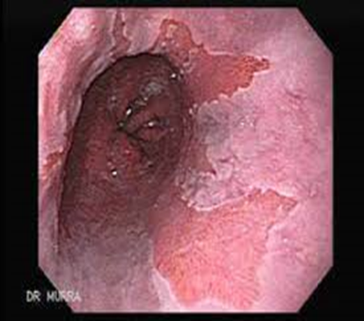
Barrett's esophagus
Endoscopic picture
• endoscopy shows tongue like projection of
erythematous epithelium above Z-line in
distal esophagus; diagnosis of BE relies on
biopsy.
Significance
• BE predisposes first to premalignant changes characterized as low or high-grade dysplasia, which then progresses to adenocarcinoma.
Malignant transformation rate of Barrett's esophagus
prior to dysplasia | 0.12% per year
high-grade dysplasia | 32-59% over 5-8 yr of surveillance

Slide 24
Treatment of Barret’s Esophagus
• Acid suppressive therapy with high-dose PPI indefinitely (or surgical fundoplication).
• No dysplasia
- Endoscopy every 3 years till no metaplasia.
• Low grade dysplasia
Surveillance every 1 year till (2) no dysplasia.
Endoscopic ablation/resection.
Both are satisfactory options.

Slide 25
Treatment of Barret’s Esophagus
• High grade dysplasia
Regular and frequent surveillance with intensive biopsy (3 months).
Endoscopic ablation/resection.
Esophagectomy.
All produce similar outcomes; however, evidence increasingly favouring endoscopic ablation with mucosal resection or radiofrequency ablation.

Slide 26
Peptic Stricture (from Esophagitis)
• It presents as dysphagia alongside a long history of reflux symptoms, but reflux symptoms may disappear as stricture develops.
• Diagnosed with endoscopy or barium study if endoscopy contraindicated.
Treatment
• Endoscopic dilatation and indefinite PPI.

Slide 27
Peptic ulcerative diseases (PUD)

Slide 28
Peptic Ulcer Disease (PUD)
Definition
• Focal defects in the mucosa that penetrate the muscularis mucosal layer results in scarring (defects superficial to the muscularis mucosa are erosions - do not cause scarring).
• Peptic ulcer disease includes defects located in the stomach (gastric ulcers - GU) and duodenum (duodenal ulcers - DU).

Slide 29
PUD: Etiology
Etiology
Helicobacter pylori (90% of DU, 60% of GU)
NSAID (GU > DU)
Stress induced ulcer
Less common causes - Zollinger-Ellison syndrome - CMV - Ischemia - Malignancy - Crohn's disease - Idiopathic
Alcohol: damages gastric mucosa but rarely causes ulcers.

Slide 30
PUD: Clinical pictures
- Silent ulcer: may be recognized only with a complication (most commonly hemorrhage or perforation), or discovered incidentally when a diagnostic test is performed for other reasons.
- Abdominal pain: (Typical presentation)
Epigastric & may radiate to the back.
Usually described as a dull ache but may be sharp or burning.
- Dyspepsia.

Slide 31
DU Vs GU
 | Duodenal Ulcer | Gastric Ulcer
Age | More in 30-40 yrs. | Above 50 yrs.
Acid secretion | Hypersecretion | Hyposecretion
Sleep interruption & Hunger pain | More | Less
Pain in Relation to meal | Decreased (Buffer effect) (pain occurs after 3-5 hr after meal) | Increased (0.5-1 hr)
Appetite | Increased | Afraid to eat
Body weight | Gain of weight | Loss of weight
Malignant change | Very rare | More common
N.B.: These features aren’t specific.

Slide 32
Acid secretion in PUD
In DU usually associated with H.pylori of antrum → suppression of somatostatin cell and stimulation of gastrin secretion from G cell → ↑ acid secretion.
In GU, associated wit H.pylori causes inflammation of gastric corpus → affect parietal cell → ↓ acid secretion.

Slide 33
PUD: Complications
Bleeding 10% (severe if from gastro-duodenal artery).
Perforation 2% (usually anterior ulcers).
Gastric outlet obstruction 2%.
Penetration 2%; may -> pancreatitis.
Gastric carcinoma in GU.

Slide 34
Investigations for PUD
• H. pylori tests.
• Endoscopy (most accurate) ; a biopsy of GU is necessary to exclude malignancy.
• Upper GI series (Barium meal).
• Fasting serum gastrin measurement if Zollinger-Ellison syndrome suspected (but most common cause of elevated serum gastrin level is atrophic gastritis).

Slide 35
Treatment of PUD
• Diet: No modifications. But some people have fewer symptoms if they avoid caffeine, alcohol and spices.
• Cigarette smoking: Discontinue.
• Specific management of etiology:
- Stop NSAIDs if possible.
- Eradicate H. pylori if present.
• Start PPI: inhibits parietal cell H+/K+-ATPase pump which secretes acid, heals most ulcers, even if NSAIDs are continued.
• Other medications (e.g. histamine H2-antagonists) less effective.

Slide 36
H.pylori

Slide 37
H. pylori-Induced Peptic Ulceration
- H.Pylori is curved, flagellated, gram negative rods found only in gastric epithelium or in regions of gastric metaplasia.
- It is the most common worldwide microbial infection, (50% of the world’s population).
Mode of transmission: fecal-oral route.
Epidemiology
- Mostly acquired in childhood.
- High prevalence in low socioeconomic status and developing countries.

Slide 38
H. pylori-Induced Peptic Ulceration
Clinical outcome
• Chronic superficial gastritis (non-erosive): 100% of patients but asymptomatic.
• Peptic ulcer in 15-20 % of patients.
• Mucosa associated lymphoid tissue [MALT] lymphoma in (monoclonal B-cell proliferation), rare.
• ↑ risk for intestinal-type gastric cancer: in patients with severe atrophic gastritis, corpus-predominant gastritis, or both, along with intestinal metaplasia.

Slide 39
Diagnosis of H Pylori
Test |  | Advantage | Disadvantage
Non-invasive
C¹⁴ Urea breath test | Optimal test for diagnosis & eradication (highest sensitivity & specificity) |  | - False -ve with use of PPI & antibiotic - Need specific laboratory | - False -ve with use of PPI & antibiotic - Need specific laboratory
Stool antigen | - Easy sampling - Cheap - High sensitivity & specificity that may replace urea breath test in diagnosis & eradication |  | - False -ve with use of PPI & antibiotic - Unacceptable for some patients | - False -ve with use of PPI & antibiotic - Unacceptable for some patients
Serology (Ig G) | May be used in untreated patients |  | - Remain positive after treatment | Remain positive after treatment

Slide 40
Diagnosis of H Pylori
Test | Advantage | Disadvantage
Invasive (require endoscopy)
Histology | - Gold-standard test | - Invasive, high cost - False -ve with use of PPI
Rapid urease test | Rapid, inexpensive, simple | - Invasive - False -ve with use of PPI
Microbiology culture | - Research only | - Invasive – delayed results
Test of H.pylori should be delayed for 2 weeks after stoppage of PPI or 4 weeks after stoppage of antibiotics to avoid false negative tests.

Slide 41
Management of H Pylori
[A] Triple therapy for 7-14 d:
- PPI (e.g. Omeprazole 40 mg - lansoprazole 30 mg) bid + amoxicillin 1 g bid + clarithromycin 500 mg bid.
Metronidazole 500 mg bid may replace clarithromycin especially in area with high clarithromycin resistance.
For patients in whom such therapy fails, a 14-day course of quadruple therapy (Either bismuth or non-bismuth based)
[B] Bismuth based Quadruple therapy for 10-14 d:
- PPI bid + bismuth 525 mg qid + tetracycline 500 mg qid + metronidazole 500 mg tid.
- Amoxicillin 1 g bid may replace tetracyclin.

Slide 42
Management of H Pylori
[C] Non-Bismuth based quadruple therapy:
• Sequential therapy:
Days 1-5: PPI bid + amoxicillin 1 g bid.
Days 6-10: PPI bid + clarithromycin 500 mg bid + Metronidazole 500 mg bid.
• Hybrid therapy:
- Days 1-5: PPI bid + amoxicillin 1 g bid.
- Days 6-10: PPI bid + amoxiciliin 1 g bid + clarithromycin 500 mg bid + Metronidazole 500 mg bid.
• Concomitant therapy: (Duration of therapy 10-14 day)
Combines PPIs with all three antibiotics throughout duration.

Slide 43
Management of H Pylori
• Levofloxacin based therapy (Salvage antimicrobial): can replace metronidazole or tetracycline.
• Continuation of acid suppressive therapy after antibiotic treatment is needed only when symptoms persist or in cases of complicated ulcer disease until eradication of H. pylori has been confirmed.
5-15% of cases are resistant to all known therapies.

Slide 44
NSAID & Stress Induced Ulceration

Slide 45
NSAID-Induced Ulceration
Pathophysiology:
• Direct: erosions/petechiae – are due to local effect of drug on gastric mucosa.
• Indirect: systemic NSAID effect (intravenous NSAID causes ulcers, but not erosions), inhibits mucosal cyclooxygenase, leading to decreased synthesis of protective prostaglandins, thus leading to ulcers.
• NSAID use causes gastric mucosal petechiae in virtually all, erosions in most, ulcers in some (25%).
• Erosions bleed, but usually only ulcers cause significant bleeding.

Slide 46
NSAID-Induced Ulceration
Clinical picture:
• Most NSAID ulcers are clinically silent.
• NSAIDs more commonly cause gastric ulcers than duodenal ulcers.
• May exacerbate underlying duodenal ulcer disease.
• NSAID-induced ulcers characteristically present with complications (bleeding, perforation, obstruction).

Slide 47
Stress-Induced Ulceration
Definition:
• Ulceration or erosion in the upper GI tract (Usually gastric fundus) of critically ill patients, usually in ICU (stress is physiological, not psychiatric).
Pathophysiology:
• Unclear: likely ischemia; may be caused by CNS disease, acid hypersecretion, Cushing ulcers.
Risk Factors:
• Mechanical ventilation • Multi-organ failure
• Anti-coagulation • Septicemia
• Major surgery/trauma • CNS injury (“Cushing’s ulcers”)
• Burns involving more than 35% of body surface

Slide 48
Stress-Induced Ulceration
Clinical Features:
• Painless
• UGIB
Treatment:
• Prophylaxis with gastric acid suppressants decreases risk of UGIB; PPI most potent but may increase risk of pneumonia; H2 blockers less potent but less risky
• Treatment same as for bleeding peptic ulcer but often less successful

Slide 49
Gastritis

Slide 50
Gastritis
Definition:
• The term gastritis should be reserved for histologically documented inflammation of the gastric mucosa.
Etiology:
• some causative agents may play a role in more than one type of gastritis and 1 patient may have histopathological evidence of more than one type of gastritis.

Slide 51
Gastritis: Etiology
Classification of Gastritis
[A] Acute gastritis - H.pylori/NSAID/physiological stress
[B] Chronic atrophic gastritis - Type A: Autoimmune, body-predominant - Type B: H. pylori–related, antral-predominant - Indeterminate
[C] Other causes of chronic gastritis - NSAID - Bile - Radiation - Lymphocytic: Celiac disease - Eosinophilic: food allergies - Non-infectious granulomatous: Crohn's disease, sarcoidosis - Other infections: TB, viruses, fungi, parasites

Slide 52
Gastritis: Clinical pictures
Acute Gastritis:
- Sudden onset of epigastric pain.
- Nausea, and vomiting.
- Bleeding in sever cases.
- If not treated, this picture will evolve into one of chronic gastritis.
N.B.: Hypochlorhydria lasting for up to 1 year may follow acute H. pylori infection.

Slide 53
Gastritis: Clinical pictures
Chronic Gastritis:
Dyspepsia - Epigastric pain – Nausea – Vomiting
Type A: Autoimmune, body-predominant: (Antral sparing)
- Pernicious anemia (megaloblastic anemia, neurologic dysfunction)
- Presence of circulating antibodies against parietal cells (directed against H+,K+-ATPase) and IF
- Gastrin levels can be markedly elevated (antrum sparing containing G cell + loss of feedback inhibition of gastrin release from G cell as a result of achlorohydra) → gastric carcinoid tumors

Slide 54
Gastritis
Type B: H. pylori–related, antral-predominant
Usually progress & affect other parts of stomach → Pangastritis.
Investigations of gastritis:
Endoscopy & multiple biopsies.
Treatment of gastritis:
• Non-pharmacological: avoidance of mucosal irritants such as alcohol, NSAIDs, and foods that trigger symptoms.
• Pharmacological: determined by etiology.

Slide 55
Esophageal motility disorders

Slide 56
Esophageal motility disorders
This include:
Achalasia
Diffuse esophageal spasm
Jackhammer esophagus
Hypertensive peristalsis
Isolated incomplete relaxation of the lower esophageal sphincter

Slide 57
Achalasia
Definition:
It is characterized by insufficient relaxation of the lower esophageal sphincter (LES) accompanied by loss of esophageal peristalsis.
Epidemiology:
Age: 30 and 60 years.
Gender: equal distribution in men and women.

Slide 58
Achalasia
Pathophysiology
Injury to the lower esophageal sphincter neurons in myenteric plexus → relative selective deficiency of nitric oxide → Failure of LES to relax.
The triggering event is unclear, but a viral cause is suggested.
Mechanism of aperistalsis is unclear.

Slide 59
Clinical picture of achalasia
[A]Dysphagia to both liquids and solids (cardinal symptoms).
[B] Regurgitation.
[ C] chest pain.
[D] Symptoms of complication:
- Heartburn (esophageal stasis of acidic food content).
- Weight loss.
- Aspiration pneumonia.
- Esophageal carcinoma (predispose to squamous cell carcinoma).

Slide 60
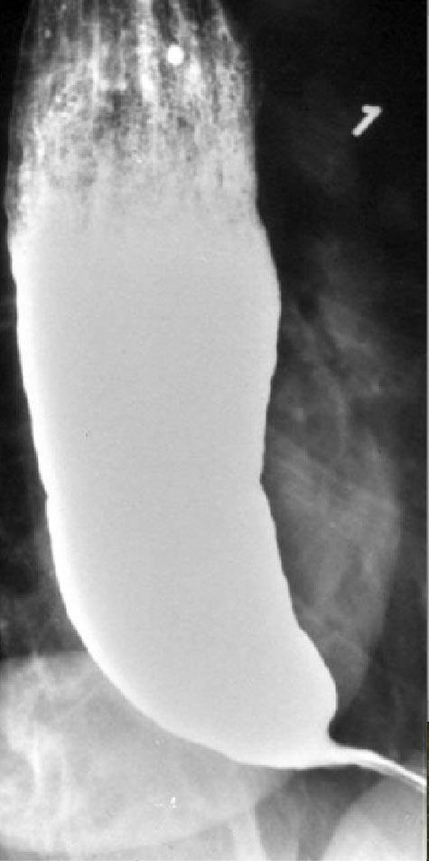
Achalasia: Investigations
[A] Barium swallow:
Esophageal dilation.
Stasis of contrast material
“bird’s beak” appearance to the lower esophageal sphincter.

Slide 61
Achalasia: Investigations (cont.)
[B] High-resolution manometry : demonstrates
High residual pressures of the lower esophageal sphincter.
Classification systems based on manometric findings of esophageal body.
Achalasia Subtypes | Manometric finding
Type 1 (classic achalasia) | Absent contractility of esophageal body
Type 2 | Intermittent period of simultaneous panesophageal pressurization after a swallow
Type 3 | associated with luminal obliterating contractions after a swallow.

Slide 62
Achalasia: Investigations (cont.)
[C] Endoscopy
It is recommended to exclude secondary causes of achalasia, such as gastroesophageal junctional cancer. Occasionally, patients present with a massively dilated esophagus and marked food retention.

Slide 63
Achalasia: Differential diagnosis
Secondary achalasia or pseudoachalsia:
Due to carcinoma of gastric cardia.
Chagas' disease.
Other esophageal motility disorders.
Other causes of dysphagia.

Slide 64
Achalasia: Management
(1) Medical therapy : nitrates and calcium channel blockers to lower sphincter pressures and with PPIs.
(2) Endoscopic Botulinum toxin injection: to lower LES pressures.
(3) Endoscopic Pneumatic dilation to facilitate luminal opening.
(4) Esophageal myotomy, performed either laparoscopically or in the traditional transthoracic approach (Heller myotomy) or Peroral endoscopic myotomy.

Slide 65

Diffuse Esophageal Spasm
Pathophysiology:
Not understood, but ↓ nitric oxide in the esophageal body may lead to a loss of control of esophageal peristalsis, high pressures, and rapid velocity contractions.
C/P: intermittent chest pain, dysphagia, or both.
Barium swallow: “corkscrew” esophagus with multiple simultaneous contractions that narrow or obliterate the lumen.
Manometry by premature rapid contractions in at least 20% of all swallows, accompanied by normal peristalsis.

Slide 66
Quiz

Slide 67
Quiz (1)
A 22 year-old lady is presenting by heart burn that is relieved by PPI. The most common cause of her disease is:
inappropriate transient relaxations of LES
low basal LES tone
Acid hypersecretion
Delayed oesophageal clearance
hiatus hernia

Slide 68
Quiz (2)
A 22 year-old lady is presenting by heart burn that is relieved by PPI of three months duration. She denies weight loss, dysphagia or bleeding. She does not smoke. In this lady
Endoscopy is not indicated for diagnosis
Endoscopy is absolutely indicated
Esophageal manometry is essential
24 h pH monitoring is essential

Slide 69
Quiz (3)
Each one of the following is a recognised complication of gastro-oesophageal reflux disease, except:
Oesophageal carcinoma
Barrett's oesophagus
Bleeding
Achalasia
Benign strictures

Slide 70
Quiz (4)
A 53-year-old businessman is complaining of persistent heartburn despite 4 weeks trial of PPI. Clinical examination is unremarkable. Endoscopy was done & Biopsies from lower are taken that showed Intestinal metaplasia & no dysplasia.
What is the most appropriate management?
High dose PPI for 8 weeks
Indefinite high dose PPI+ endoscopic surveillance/1 years
Indefinite high dose PPI+ endoscopic surveillance/3 years
Endoscopic ablation
Oesophagectomy

Slide 71
Quiz (5)
A 35-year-old man presents with difficulty swallowing which has been present for 3 months and has been getting worse over the past few weeks. The dysphagia occurs to solids. He also has a previous history of prolonged heartburn.
What is the likely diagnosis?
Cancer oesophagus
Peptic stricture
Achalasia of the cardia
Oesophageal Web
Oesophageal ring
Notes:
B

Slide 72
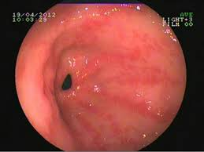
Quiz (6)
A 35 year-old lady presenting with dyspepsia & persistent vomiting, endoscopy showed picture of antral gastritis
What is the most common cause?
autoimmunity
H. pylori
NSAID
bile
Celiac disease

Slide 73
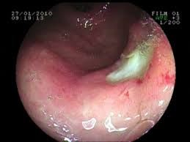
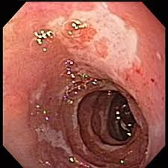
Quiz (7)
What is the 2nd most common cause of these:
H. pylori
NSAIDs
Physiologic Stress
Idiopathic
Zollinger-Ellison Syndrome

Slide 74
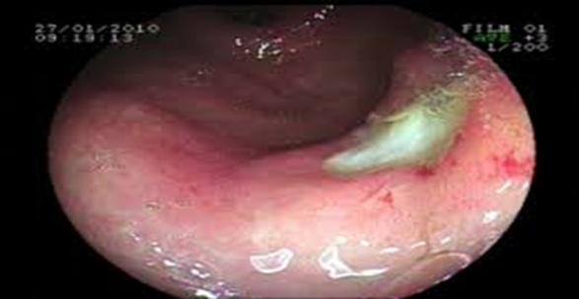
Quiz (8)
A 40 year-old gentleman presenting with dyspepsia of few months duration. Endoscopy was done & showed ➔ Gastric ulcer
What is the next step in
Management
Triple therapy
Full dose PPI for 6 wks + triple therapy for 2 wks
Endoscopic biopsy
Partial gastrectomy

Slide 75

Quiz (9)
A 40 year-old gentleman presenting with dyspepsia of few months duration. Endoscopy was done & showed ➔ Duodenal ulcer
What is the next step in
Management
Triple therapy
Full dose PPI for 6 wks + triple therapy for 2 wks
Endoscopic biopsy
Partial gastrectomy

Slide 76
Quiz (10)
A patient with upper gastrointestinal symptoms tests positive for Helicobacter pylori following a urea breath test.
Which one of the following conditions is most strongly associated Helicobacter pylori infection?
Gastric adenocarcinoma
Gastro-oesophageal reflux disease
Oesophageal cancer
Duodenal ulceration
Atrophic gastritis

Slide 77
Quiz (11)
A 36-year-old man presents with dyspepsia. No alarm symptoms are present. This is his first episode and he has no significant medical history of note. A test-and-treat strategy is agreed upon. What is the most appropriate investigation to test for Helicobacter pylori?
Gastric aspiration + culture
CLO test (rapid urease test)
H.pylori antigen in stool
Hydrogen breath test
Stool culture

Slide 78
Quiz (12)
40 year-old lady with rheumatoid arthritis and on NSAIDs. All of the following are risk factors for NSAID-induced peptic ulceration except?
previous peptic ulcers/UGIB
age (≥50 yr)
High dose/multiple NSAID
concomitant corticosteroid use
concomitant cardiovascular disease

Slide 79
Quiz (13)
The most important indication for prophylaxis with gastric acid suppressants in ICU patients is:
anti-coagulation
multi-organ failure
mechanical ventilation
severe surgery/trauma
Burns

Slide 80
Home message
Clinical diagnosis of GERD is sufficient to start a trial of PPI
Presence of alarming symptoms in patient with GERD push the physician to start investigation
PPI is the mainline of treatment in GERD
H.pylori one of the most important etiology of PUD
Stop antibiotic & PPIs before H.pylori tests.
Esophageal manometry is the main tool to diagnose different form of primary esophageal motility disorders

Slide 81
References
Goldman L, Schafer Al (Eds) (2020). Goldman-Cecil Medicine (26th ed.). Philadelphia, PA: Elsevier.
Benjamin IJ, Griggs RC, Wing EJ, Fitz JG (Eds.) (2016). Andreoli and Carpenter’s Cecil Essentials of Medicine (9th ed.). Philadelphia, PA: Elsevier Saunders.
Fauci, AS, Kasper DL, Hauser SL, Longo DL, Loscalzo J (Eds.) (2018). Harrison's Principles of Internal Medicine (20th ed.). New York: McGraw-Hill Education.

Slide 82
Thank You

